Slide 1
A few useful things to know about Machine Learning

Slide 2
Machine Learning Systems : Benefits and Opportunities
Machine Learning Systems are automated systems designed to learn programs from data, hence presenting a convenient alternative to manually constructing programs.
Boomed in last decade.
Endless number of applications, including but not limited to, Spam Filters, Recommender Systems, Ad Placements, Credit Scoring, Fraud Detection, Stock Trading, and Drug Design.
Will be the driver of innovation for years to come, according to a global study by McKinsey.

Slide 3
Purpose of the Paper
Budding Developers and ML Researchers have a lot of resources available at their disposal. However, lot of knowledge about the field gets disseminated by the word of mouth and has scarce written record.
The purpose of the paper was to provide a comprehensive collection of the ‘folk’ ML knowledge, including pitfalls to avoid, important issues to focus on, and answers to common questions.

Slide 4
Classifier Systems
The paper chooses Classifier Systems as an illustrative example, as there are too many machine learning models to be able to span all of them.
The purpose of a classifier system is the mapping of a input feature vector X to a output class vector y.
For illustration, take example of a Spam Classifier. First we build a dictionary of N words, hence our input would be N dimensioned. For every email, the input vector could be a vector X = x1, x2, … xN, where xi = 1 if the ith word is in the training example and 0 if the word is not in the training example.
The output vector would be a real number y, where y is 1 if the email is spam and 0 if the email is not spam.

Slide 5
Components of a Classifier
Three Major Components :
Representation
Evaluation
Optimization
Easy to get lost in the world of thousands of classifiers. Which one to use ? The key is to analyse the three different components separately before making a decision.

Slide 6
Representation
Every classifier is represented in some formal language such that the computer can understand it.
Choosing the representation for a classifier gives us a set of classifiers that it can possibly learn. This set is called hypothesis space.
If a classifier is not in the hypothesis space, it cannot be learnt.
Example : The theta vector in logistic regression is the representation of the logistic classifier.

Slide 7
Evaluation
If we train multiple classifiers on a set of data, they all give different results. To be able to choose a classifier, we need a performance metric which tells us how good or bad a model is. This is where Evaluation metrics or Objective Functions come in.
Two types of Evaluation Metrics :
Intrinsic : The scoring objective which is optimized by the model to give the best performance. Used internally by the algorithm. Eg : Log function in Logistic Regression
Extrinsic : The scoring criteria used by the user to differentiate between separate models. Used by the user at will. Eg : Accuracy, Precision or Recall or F1 Score in Logistic Regression

Slide 8
Optimization
Search amongst the classifier for the highest scoring one.
Different optimization techniques. A good optimizer increases efficiency of the process and can give better results in case there are local minimas in the data as well.
Off-the-shelf optimizers are commonly used for beginners. Custom optimizers replace them once you get more into the field.

Slide 9
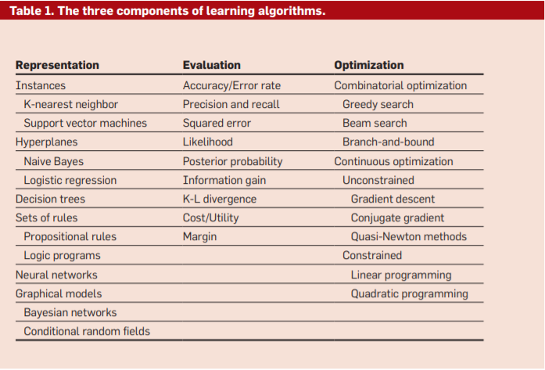

Slide 10
Algorithm of Decision Tree
The algorithm provided here is a bare-bones algorithm which uses a very trivial approach. It takes in a dataset as an argument and returns a tree. Parsing the tree for any example would give us the prediction for that example. Initially we are located at the root node.
First, check if all the examples are of same class. If yes, return a leaf (end-node) which gives result as whatever class all the examples are.
Else, check information gain or infogain for every feature and class vector. If none of the features have a positive infogain, return a leaf which gives us the class appearing maximum times in the dataset.
Else, find the feature xi which has maximum infogain. Now, add a node (not a leaf), which checks for feature xi and returns C childs, one for each class present in output vector. For every child, run the algorithm again, now using the examples in dataset which are of same class.

Slide 11
Choosing the classifier
Choosing a classifier requires picking out the aforementioned three components. Not every component is compatible with each corresponding component. For example, discrete representations naturally go with combinatorial optimization, and continuous ones with continuous optimization.
Most textbooks are organized by representation, and gloss over other components. However they are equally important.

Slide 12
Importance of Generalization
A competent ML model should be able to predict stuff for examples not in the training set.
A common mistake : training on all examples available. Always set aside a subset of data for testing the model on the examples it has not seen before.
Introduces the concept of cross validation to account for the loss of data by setting aside a subset of data.
Divide the data into 10 parts, holding out one for testing and training a classifier on rest. At the end, average out results of all 10 classifiers.

Slide 13
Additional notes on Generalization
Generalization differs from representation to representation. In earlier days, with limited representation classifiers, training error and test error didn’t differ by much. However, now with very flexible classifiers, it’s necessary to separate training and test data.
Substituting training error for test error has dangerous consequences. Using test error is a must for effective generalization.
Test error is not the objective function, merely a proxy evaluation metric. So finding absolute global optima is not necessary and a local optima is just as good.

Slide 14
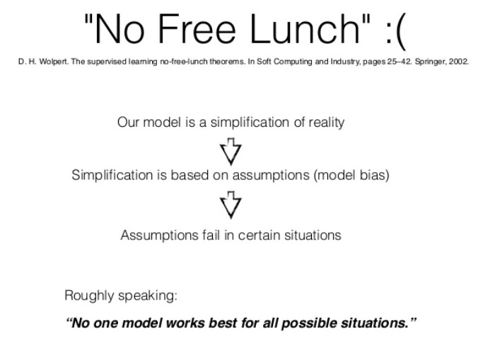
Having a lot of data alone won’t help
Our main aim till now has been generalizing our model (hypothesis) beyond the training examples
And this can not be achieved by mere data amount, no matter how much how much of it you have still there will be unclassified examples which you can not predict due to lack of information.
The way out of it: Every learner must embody some knowledge or assumptions beyond the data it is given in order to generalize beyond it. This notion was formalized by Wolpert in his famous “no free lunch” theorems,according to which no learner can beat random guessing over all possible functions to be learned.
=>Whatever amount of data you have you can’t learn everything
(generalIze to all)
=>hence to generalize you make assumption beyond the data
=> assumption obviously can fail in some cases :’(
But is it that sad i mean if mere amount of data would have been the only
Criteria for good models or hypothesis there would not be any art in
The process everyone with same amount of data would have equally efficient model and no scope of logical intuition :”)

Slide 15
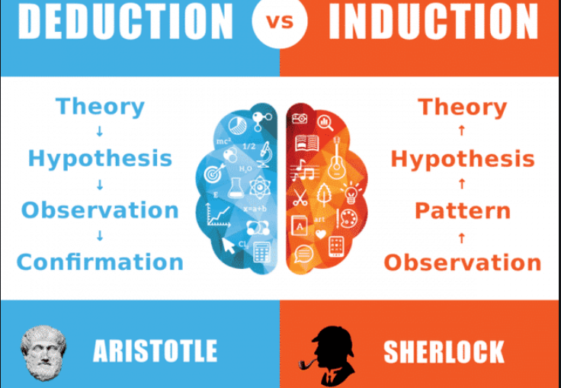
INDUCTION>DEDUCTION:
INDUCTION IS WHAT WE DO MOST OF
THE TIME WITH A NON ZERO AMOUNT
OF DATA COMBINE IT WITH OUR
KNOWLEDGE TO OBSERVE PATTERNS
AND PROPOSE A SUITABLE HYPOTHESIS

Slide 16
OVERFITTING:MAJOR BUGBEAR IN MACHINE LEARNING
When your learner outputs a classifier that is 100% accurate on the training data but only 50% accurate on test data, when in fact it could have output one that is 75% accurate on both, it has overfit.
#BIAS AND VARIANCE:
Bias is a learner’s tendency to consistently learn the same wrong thing.( assumptions made by the model to make the target function easier to approximate EVEN IF IT IS WRONG)
Variance is the tendency to learn random things irrespective of the real signal( amount that the estimate of the target function will change given different training data.)

Slide 17
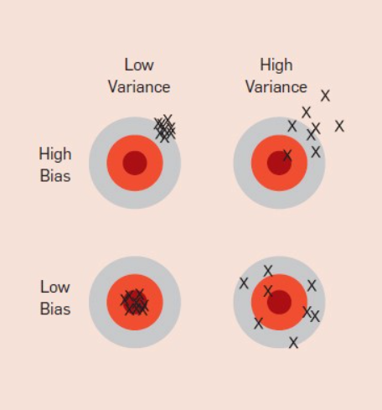
<=DARTS ANALOGY TO BIAS AND VARIANCE INTUITION
#A linear learner has high bias, because when the frontier between two classes is not a hyperplane the learner is unable to induce it. LINEAR LEARNER CAN NOT UNDERGO SUCH COMPLEX DECISION BOUNDARY
#Decision trees do not have this problem because they can represent any Boolean function, but on the other hand they can suffer from high variance: decision trees learned on different training sets generated by the same phenomenon are often very different.

Slide 18
METHODS TO COMBAT OVERFITTING:
THERE IS NO RULE OF THUMB TO AVOID OVERFITTING BUT SEVERAL METHODOLOGY WHICH WE APPLY TO OVERCOME THE LATTER,
Cross-validation can help to combat overfitting, for example by using it to choose the best size of decision tree to learn. But IT IS NOT A TYPICAL SOLUTION, since if we use it to make too many parameter choices it can itself start to overfit.
REGULARIZATION adding a regularization term to the evaluation function. This can for example, penalize classifiers with more structure, thereby favoring smaller one with less room to overfit(LASSO REGRESSION(SQR. COEFF.) AND RIDGE REGRESSION(ABSOLUTE COEFF.))
A PARTICULAR TECHNIQUE “SOLVES OVERFITTING” NOTHING AS SUCH EXIST. It is easy to avoid overfitting (variance) by falling into the opposite error of underfitting (bias) .Simultaneously avoiding both requires learning a perfect classifier, and short of knowing it in advance there is no single technique that will always do best (no free lunch).

Slide 19
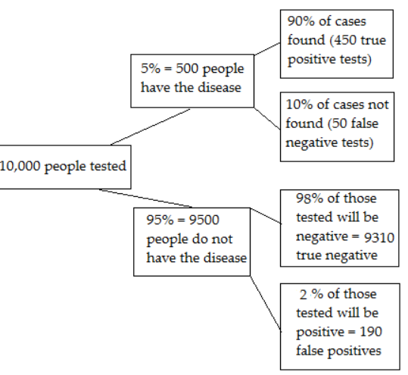
PROBLEM OF MULTIPLE TESTING AND ITS CORRELATION WITH OVERFITTING
Standard statistical tests assume that only one hypothesis is being tested, but modern learners can easily test millions before they are done. As a result what looks significant may in fact not be.
SO THERE IS A CHANCE THAT YOU PICK A WRONGLY OVERFITTED MODEL OUT OF THE POOL OF HYPOTHESIS WHICH MIGHT LOOK GOOD WHILE MULTIPLE TESTING
A better approach is to control the fraction of falsely accepted non-null hypotheses, known as the false discovery rate.

Slide 20
ANOTHER BUGBEAR:”THE CURSE OF DIMENSIONALITY”
Generalizing correctly becomes exponentially harder as the dimensionality (number of features) of the examples grows, because a fixed-size training set covers a dwindling fraction of the input space
FOR INSTANCE Consider a nearest neighbor classifier with Hamming distance as the similarity measure, and suppose the class is just x1 ∧ x2. If there are no other features, this is an easy problem. But if there are 98 irrelevant features x3,..., x100, the noise from them completely swamps the signal in x1 and x2, and nearest neighbor effectively makes random predictions.

Slide 21
INTUITION FAILS IN HIGHER DIMENSIONS
In high dimensions, most of the mass of a multivariate Gaussian distribution is not near the mean, but in an increasingly distant “shell” around it; SAY most of the volume of a high dimensional orange is in the skin, not the pulp. If a constant number of examples is distributed uniformly in a high-dimensional hypercube, beyond some dimensionality most examples are closer to a face of the hypercube than to their nearest neighbor. And if we approximate a hypersphere by inscribing it in a hypercube, in high dimensions almost all the volume of the hypercube is outside the hypersphere.
This is bad news for machine learning, where shapes of one type are often approximated by shapes of another.

Slide 22
“BLESSING OF NON-UNIFORMITY COUNTERING THE CURSE”
THis refers to the fact that observations from real-world domains are often not distributed uniformly, but grouped or clustered in useful and meaningful ways.
THAT IS INSTEAD OF BEING UNIFORMLY DISTRIBUTED IN HIGH DIMENSIONAL SPACE EXAMPLES ARE RATHER CONCENTRATED AT A LOWER DIMENSIONAL MANIFOLD
Learners can implicitly take advantage of this lower effective dimension
OR RATHER CAN USE SOME SPECIFIC METHODS TO REDUCE DIMENSIONALITY SUCH AS TENNEBAUM’S THEOREM

Slide 23
THEORETICAL GUARANTEES ARE NOT WHAT THEY SEEM

Slide 24
WHAT DOES IT MEAN?
If theory says it is possible, but in practice it is not always such a good idea....
Theory is too conservative, but in practice it works pretty well....
Be careful about the theoretical meaning....

Slide 25
THEORY SAYS IT IS POSSIBLE, BUT IN PRACTICE IT IS NOT ALWAYS SUCH A GOOD IDEA...
EXAMPLE
The universality theorem asserts that neural networks can compute any computable function. Such a statement gives the impression that NN architectures are extremely powerful and can be applied to very different types of problems…
It does not say anything about how to find such a NN in the hypothesis space.
A NN with one hidden layer might be equivalent to a deep NN in terms of representational power.
The theorem should not be read as NNs being better than other machine learning algorithms in any general sense.

Slide 26
THEORY IS TOO CONSERVATIVE, BUT IN PRACTICE IT WORKS REALLY WELL....
CONVENTIONAL THOUGHT
Induction was traditionally contrasted with deduction:
In deduction you can guarantee that the conclusions are correct.
In induction all bets are off.
NEW VISION
Results of induction can be trusted:
One of the major developments of recent decades has been the realization that in fact we can have guarantees on the results of induction, particularly if we are willing to settle for probabilistic guarantees.

Slide 27

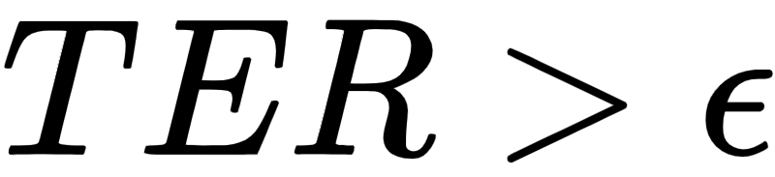
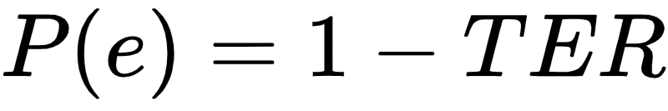
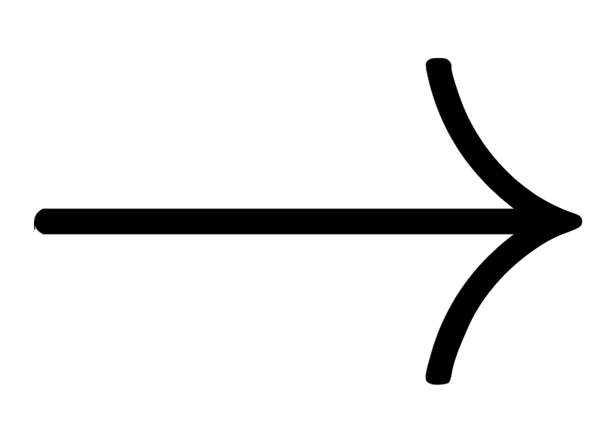
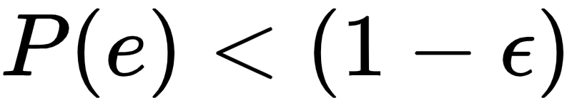
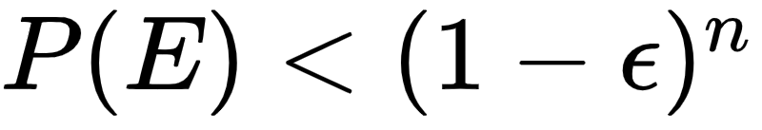
EXAMPLE
There are a number of theoretical bounds which make claims about number of training samples given the number of parameters in a model required for good generalization.
Let’s say a classifier is bad if it’s True Error Rate(TER) is greater than .
The event that a bad classifier is consistent with n random independent training examples be E.
The event that a bad classifier is consistent with 1 random training examples be e.c

Slide 28
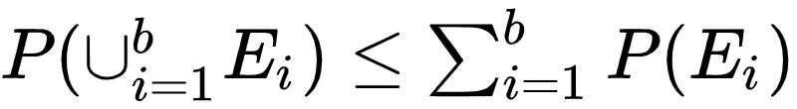
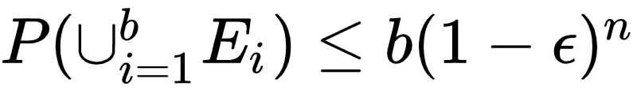
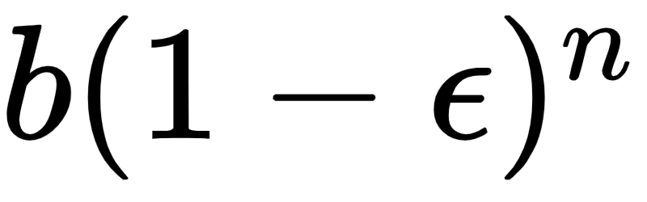
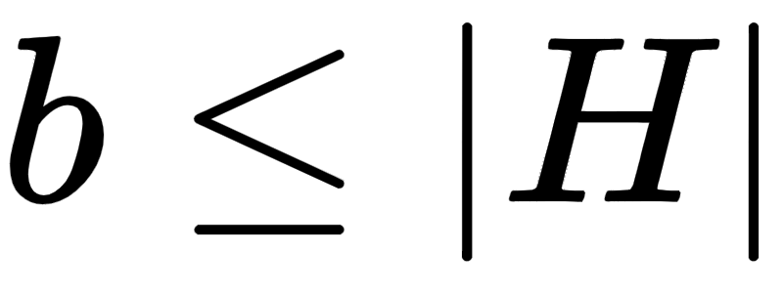
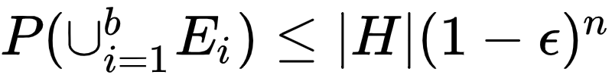
continued….
Now, Let b be the number of bad classifiers in the learner’s hypothesis space H.
We know that for every bad classifier
PROBABILITY MEASURE IS SUBADDITIVE.
Subadditivity effect states that P of whole to be less than parts of whole.
I.e. The probability that at least one of them is consistent is less than
Since

Slide 29

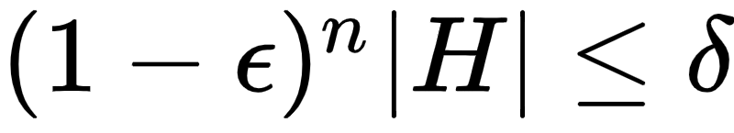
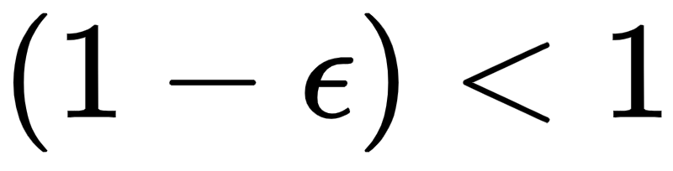
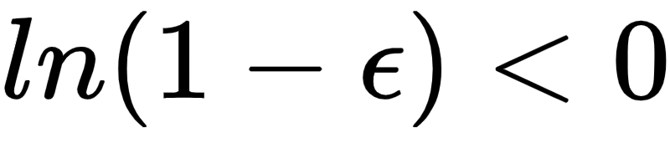
continued….
So if we want the probability to be less than
Since therefore
The bounds obtained by this method are way too loose
Observation - The required number of examples grows logarithmically with |H| and

Slide 30
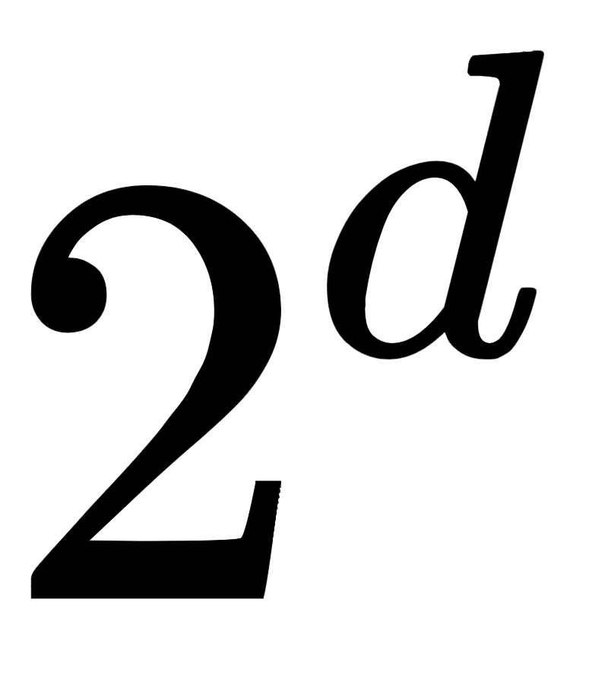
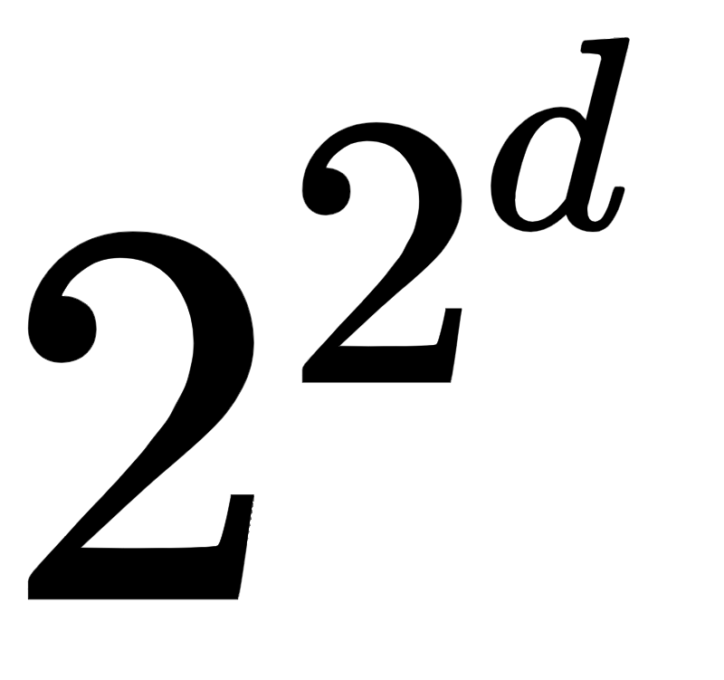
EXAMPLE
Most interesting hypothesis spaces are doubly exponential in the number of features d,
which still leaves us needing a number of examples exponential in d.
Let’s consider the space of Boolean functions of d Boolean features(of an input) and
an output.
So we get the total number of possible inputs = (Because each feature can have 2 values)
For each possible input combination we can have 2 output values
Total number of functions =
And even for hypothesis spaces that are “merely” exponential, the bound is still very loose, because the union bound is very pessimistic.

Slide 31
Be Careful about the Theoretical Meaning....
It does not say that, if your learner returned a hypothesis consistent with a particular training set, then this hypothesis probably generalizes well.
It means, given a large enough training set, with high probability your learner will either return a hypothesis that generalizes well or be unable to find a consistent hypothesis.
Another common type of theoretical guarantee is asymptotic:
Given infinite data, the learner is guaranteed to output the correct classifier. This is reassuring, but it would be rash to choose one learner over another because of its asymptotic guarantees.
And, because of the bias-variance trade-off, if learner A is better than learner B given infinite data, B is often better than A given finite data.

Slide 32
TWO FACES OF THE SAME COIN
If the hypothesis space contains the true classifier, then the probability that the learner outputs a bad classifier decreases with training set size.
If we shrink the hypothesis space, the bound improves, but the chances that it contains the true classifier shrink also.

Slide 33
FEATURE ENGINEERING IS THE KEY

Slide 34
WHAT IS FEATURE ENGINEERING?
WHY FEATURE ENGINEERING?
Features are attribute-value pairs, so we could add or remove columns from our data table and modify values within columns.
Feature engineering refers to manipulation—addition, deletion, combination, mutation—of the features.
Learning is easy if you have many independent features that each correlate well with the class.
Often, the raw data is not in a form that is susceptible to learning, but we can construct features from it that are.

Slide 35
METHODOLOGY
GATHERING DATA
INTEGRATING DATA
CLEANING DATA
PREPROCESSING DATA

Slide 36
PART OF A WHOLE
Machine learning is not a one shot process of building a dataset and running a learner, but rather an iterative process...
Modifying the Learner
Running the Learner
Modifying the data
Analyzing the results

Slide 37
DRIVERS OF FEATURE ENGINEERING
1
2
Background knowledge from the domain of the task.
Feature engineering is more difficult because it is domain-specific, while learners can be largely general purpose.
Inspection of the data values
We could have used automatically generated large numbers of candidate features and selecting the best by their information gain with respect to the class. But features that look irrelevant in isolation may be relevant in combination.
Running a learner with a very large number of features to find out which ones are useful in combination may be too time-consuming, or cause overfitting.

Slide 38
Examples in Broad Sense
● Scaling & Normalisation
● Filling Missing Values
● Feature Selection
● Feature Construction
● Feature Extraction
● Feature Coding

Slide 39
So there is ultimately no replacement for the smarts you put into feature engineering.

Slide 40
Topics
More Data Beats Cleverer Algorithm
Learn Many Models Not Just one
Simplicity Does not imply Accuracy
Representable does not imply learnable
Correlation Does not imply Causation

Slide 41
More Data Beats Cleverer Algorithm
More data is avalaible but takes too long to train on it
Learners can produce wildly different boundaries
Fixed size learners can only take advantage of limited data size
Variable size learners can learn any function(theoretically)
Biggest bottle neck is the human factor

Slide 42
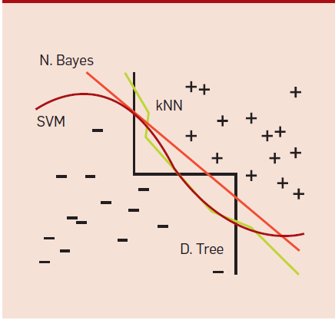

Slide 43
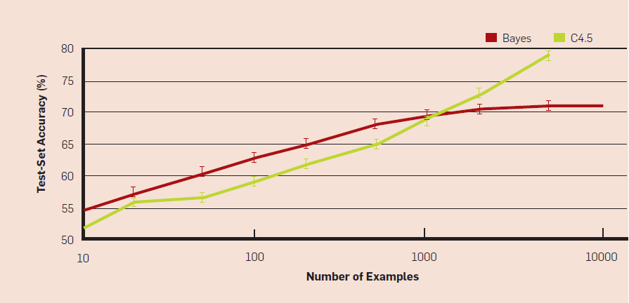

Slide 44
Learn Many Models Not Just one
Learning multiple classfiers better than focusing on just one
Bagging boosting stacking
Bayesian model averaging vs ensembling

Slide 45
Simplicity Does not imply Accuracy
No necessary connection b/w no. of parameters and overfitting
Less complex algo have smaller hypothesis space
Higher complexity algo have larger hypothesis space
Simpler algo should be chosen as simplicity is a virtue in its own right no connection with accuracy

Slide 46
Representable does not imply learnable
Every function can be represented but not learned
Limitations due to dependence of data
May get stuck in local minima
Only limited subset of functions can be learned and this depends on the learner

Slide 47
Correlation Does not imply Causation
Often predictive algos are used as guides to actions
But difficult to tell whether itll work without performing real experiment
Correlation is potential connection between data and can be used as guide for further investigation
If we can obtain experimental data then we can apply ml predictions in real world

Slide 48
THANKS
Sources
https://images.app.goo.gl/qmgFYcSaehKVMenc7
https://www.statisticshowto.com/false-discovery-rate/
https://en.wikipedia.org/wiki/Tennenbaum_theorem
(Occam’s Razor)
https://users.soe.ucsc.edu/~manfred/pubs/J9.pdf
https://www.commonlounge.com/discussion/eb7f72d1fac54fc9b9a4dbc4a157074e
https://blog.dominodatalab.com/manual-feature-engineering/
ORIGINAL PAPER SOURCE: https://homes.cs.washington.edu/~pedrod/papers/cacm12.pdf

